Slide 1
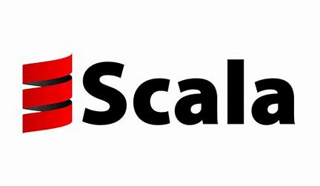
What is Scala
Presented by: BJ Dotterer, Conler Simmons, and William Matz

Slide 2
What is Scala? - William
Scala is a high-level, general purpose programming language that has the capability to support both object-oriented programming and functional programming!
Scala is interoperable with Java as they both run on the JVM(Java Virtual Machine)
Scala is used for Data, Video Transcoding, Information Processing, and big data projects

Slide 3


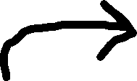
The Origin of Scala - Conler
Scala was released on Jan 20th, 2004 by Martin Odersky
The goal was to combine functional programming as well as object-oriented programming
Scala stands for “Scalable Language”
Scala is influenced by Java as well as Lisp, Haskell, and Pizza

Slide 4
Goals of Scala - Conler
Scala wanted no concept of primitive data and made everything an object
Scala is meant to be a safe programming language to prevent data from leaking outside of its intended bounds
Scala was developed to address Java’s verbosity and other issues. It was also created to express general programming patterns in a concise, refined, and type-safe way

Slide 5
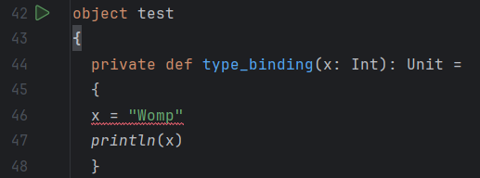

Language Types: Binding & Types - BJ
Scala types: includes all Java types and a new object (singleton) type
Scala does type binding statically at compile time where once it is compiled it cant be changed
Scala is a strongly typed language where as variables and values must stick to their designated types throughout the running of the program without change

Slide 6
Language Types: Continued - BJ

Slide 7
Language features - Control Statements – William
Standard control flow: if, while, for
Scala includes familiar constructs like if, while, and for, so developers coming from Java or C will feel comfortable
Pattern matching (advanced switch)
This is like a smarter switch statement that works with data structures, types, and conditions — great for clean branching logic
For-comprehensions for data pipelines
These are readable and powerful ways to work with collections and monads, allowing multiple steps in a loop-like format
Higher-order functions for iteration
Instead of traditional loops, Scala often uses map, filter, reduce, etc., which take functions as arguments for elegant, functional iteration
Functional alternatives to loops
Recursion and immutability are preferred over imperative looping, leading to clearer, more predictable code in many cases

Slide 8
Language features – Memory Management - Conler
Java Virtual Machine: base for Java and also for Scala
Utilizes heaps and stacks
Heap: Object/dynamic data
Stack: Method/Function Data
Garbage Collection
Utilizes Minor and Major Garbage Collection to maintain the memory

Slide 9
Language features – Abstraction and Traits – William
Traits: A kind of class similar to an abstraction class
Can have both Abstract and Concrete methods and fields
Abstract: members that will be implemented by other classes
Concrete: implemented by the trait interface itself
Can have both in a single trait interface
Abstraction
Only abstract methods
Generally used in two cases:
You want to create a base class that takes constructor arguments
The code will be called from Java code

Slide 10
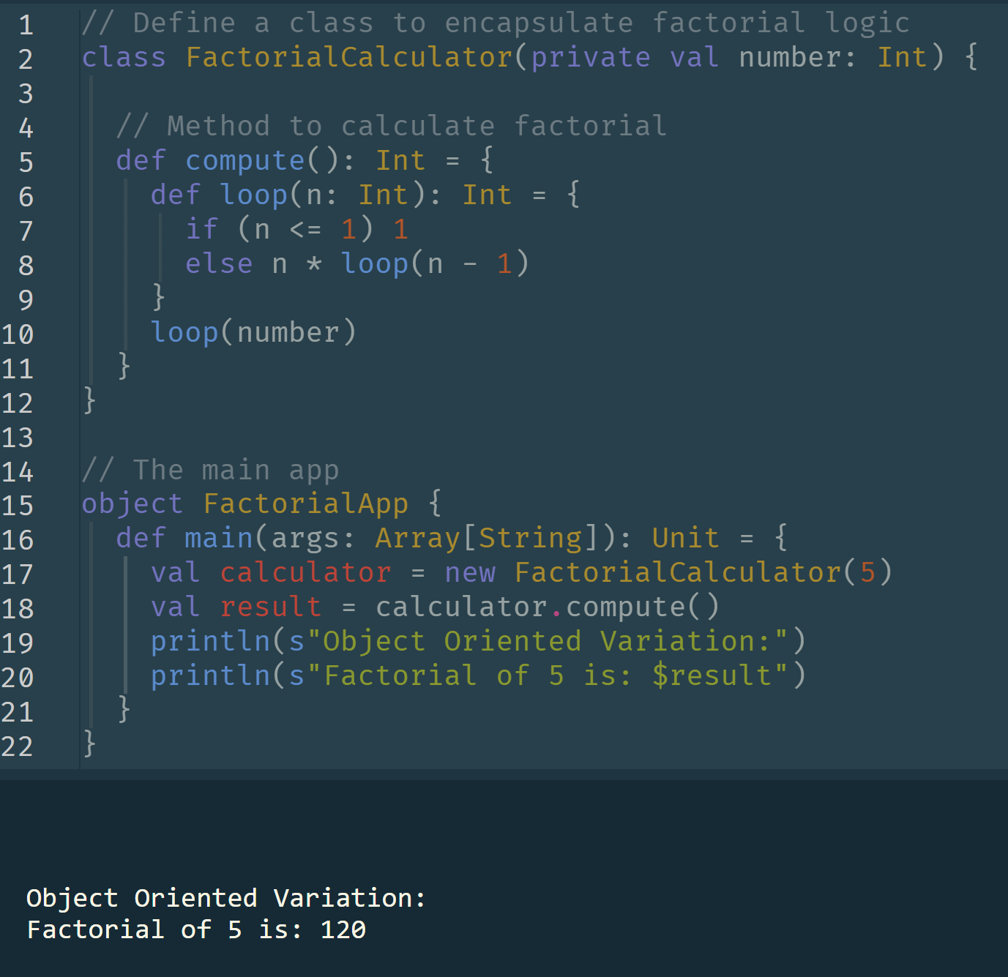
Sample Code: Object Oriented - Conler

Slide 11
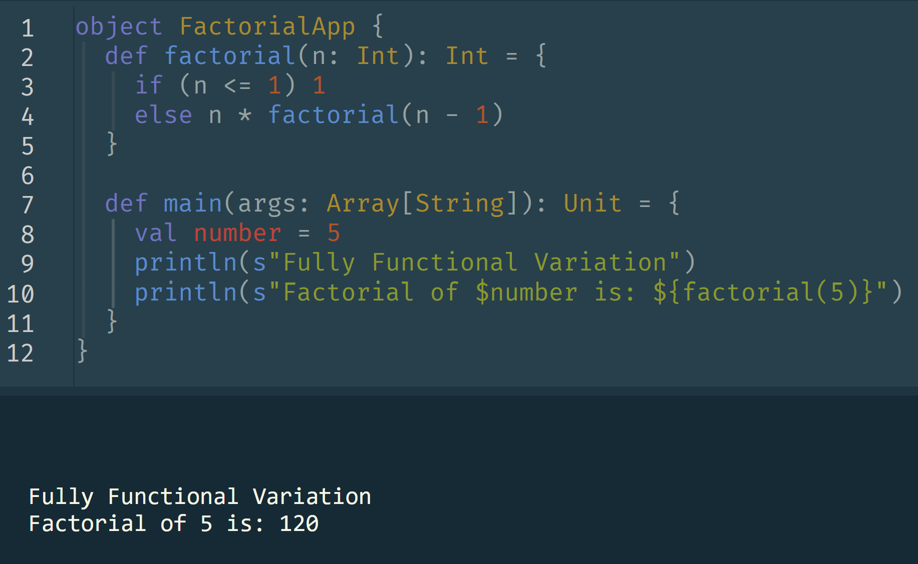
Sample Code: Fully Functional - BJ

Slide 12
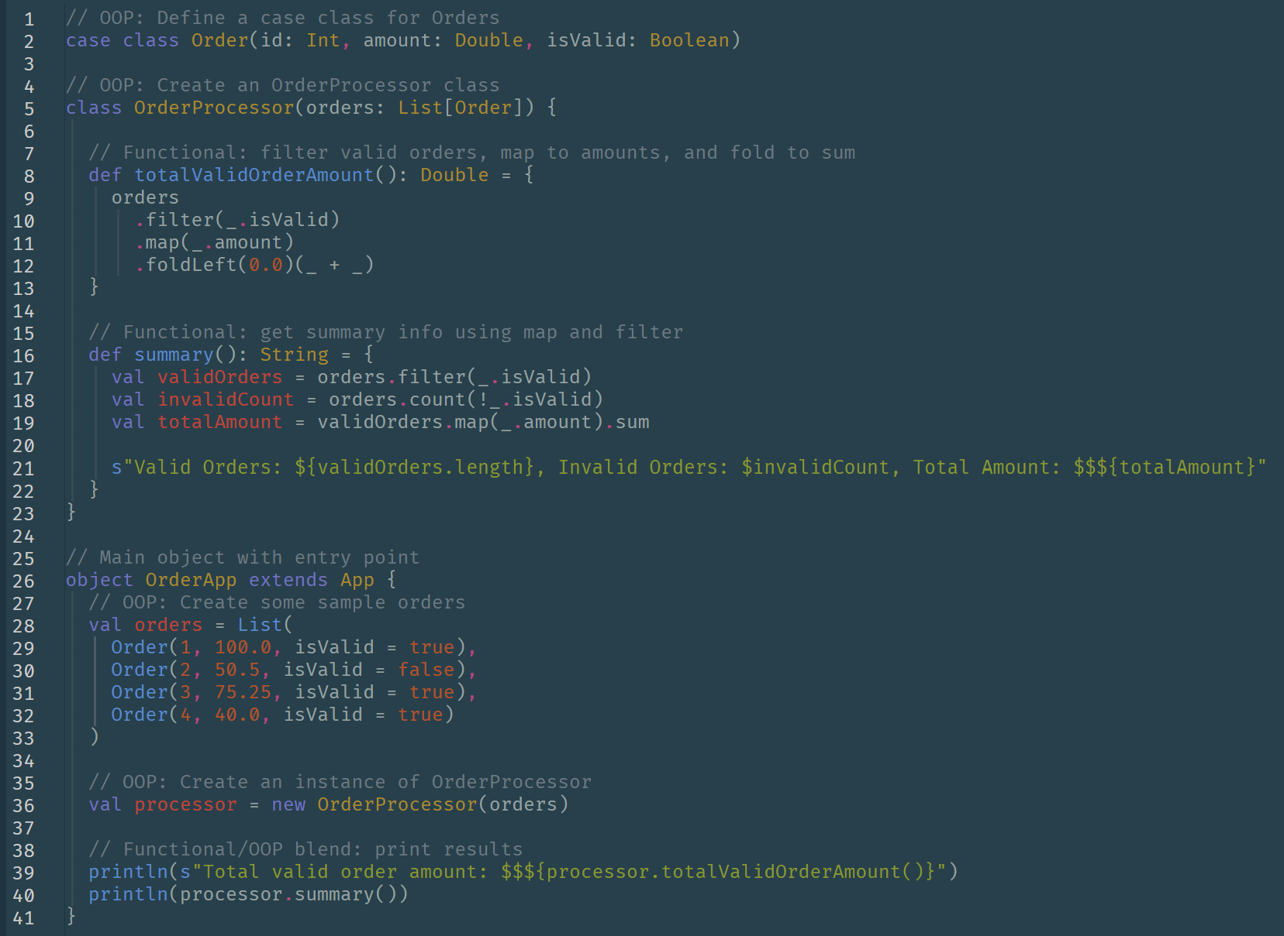
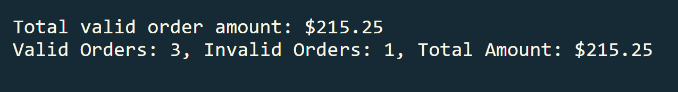
Sample Code: Object Oriented and Functional – William

Slide 13
Real World Applications - Conler
Big Data Processing – Apache Spark core is written in Scala
Scala powers Spark, which handles large-scale data processing across distributed systems. Its functional style is great for writing clean, parallelized operations.
Real-Time Systems – Used by Twitter & LinkedIn for high-speed backend operations
Scala is used in apps that require speed and scalability — like Twitter for message queues and LinkedIn for live data streams and content feeds.
Finance & Trading – Common in risk modeling and algorithmic trading
Scala’s strong typing and immutability help prevent errors in financial calculations, which is crucial in banking and trading systems.
Web Development – Play Framework supports scalable, reactive apps
With Play Framework, Scala can build responsive, event-driven web apps, useful in high-traffic platforms.
Concurrent & Distributed Systems – Scala supports tools like Akka for managing concurrency
Tools like Akka use Scala to handle high-concurrency environments — ideal for chat apps, APIs, and microservices.
Interoperability with Java – Ideal for large enterprise systems needing JVM compatibility
Since Scala runs on the JVM, it’s easily integrated into existing Java-based enterprise systems, which saves time and resources in large organizations.

Slide 14
Why Use Scala - Conler
Combines OOP + Functional Programming
Scala gives you the flexibility to write code in an object-oriented or functional style—or both—depending on what fits the problem.
Concise, expressive syntax
It reduces boilerplate code, so developers can write more with less, improving readability and productivity.
Strong static typing reduces bugs
Its type system catches many errors at compile time, which improves code reliability in large projects.
Excellent for concurrency & data processing
With libraries like Akka and frameworks like Spark, Scala handles parallel tasks and large datasets efficiently.
JVM-based = Easy Java integration
Scala works seamlessly with existing Java codebases, making it easy for teams to adopt gradually.
Scalable for small scripts to large systems
Whether you’re prototyping or building enterprise software, Scala can handle the scale and complexity.

Slide 15
Challenges & Trade-offs - BJ
Steep learning curve (esp. functional concepts)
Scala’s blend of object-oriented and functional programming can be hard to grasp, especially for beginners or teams without FP experience.
Slower compile times
Scala tends to compile slower than Java, which can slow down development in larger projects.
Smaller community & fewer resources
Compared to Python or JavaScript, Scala has fewer libraries, tutorials, and active forums, making troubleshooting more challenging.
Inconsistent code style across teams
Its flexibility allows multiple coding styles, which can lead to inconsistent codebases if teams don’t enforce standards.
Overhead of JVM
While JVM compatibility is a strength, it also adds startup time and memory overhead, which may not be ideal for lightweight applications.

Slide 16
Summary & key Takeaways - William
Scala = Scalable + expressive
The name says it all — Scala is built to grow with your codebase, without losing clarity or flexibility.
Blends object-oriented & functional programming
You don’t have to choose one paradigm — Scala lets you use both seamlessly depending on the problem.
Used in big data, finance, and real-time systems
From Apache Spark to banking systems, Scala is trusted where performance and reliability are critical.
Concise, type-safe, and powerful
Its syntax is clean and its static typing helps catch errors early — making large-scale development safer and faster.
Best for complex, data-heavy, and concurrent applications
With tools like Akka and Spark, Scala is ideal for building modern, high-performance systems.
Learning curve, but high reward
It may take time to master, especially functional aspects, but the scalability and power make it worth the investment.

Slide 17
References
Odersky, M., Spoon, L., & Venners, B. (2016). Programming in Scala (3rd ed.). Artima Press.
Scala Documentation. (n.d.). Retrieved from https://docs.scala-lang.org
Lightbend. (n.d.). What is Scala? Retrieved from https://www.lightbend.com/scala
Zaharia, M., et al. (2010). Spark: Cluster computing with working sets. Proceedings of the 2nd USENIX Conference on Hot Topics in Cloud Computing.
Twitter Engineering Blog. (2011). Why Twitter chose Scala. Retrieved from https://blog.twitter.com/engineering/en_us/topics/insights/2011/scala.html
LinkedIn Engineering. (n.d.). How we use Scala at LinkedIn. Retrieved from https://engineering.linkedin.com
Akka Documentation. (n.d.). Retrieved from https://doc.akka.io
Play Framework. (n.d.). High-velocity web framework for Java and Scala. Retrieved from https://www.playframework.com

